Slide 1
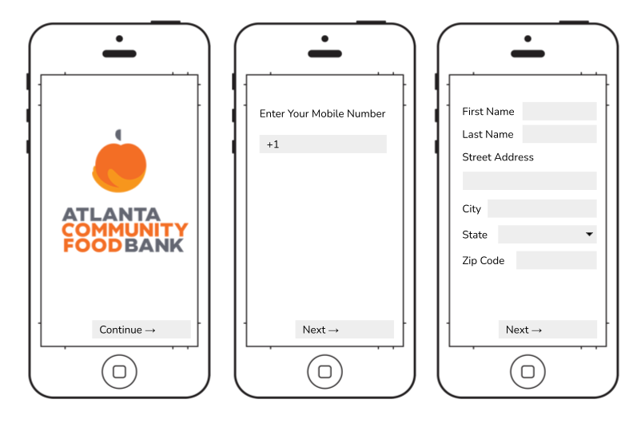
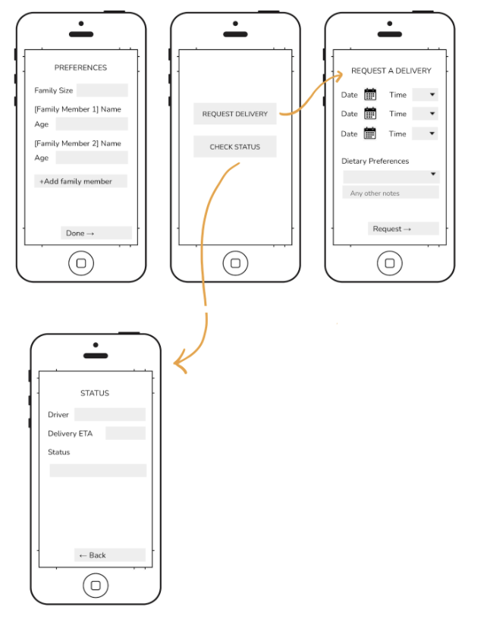

LINK TO CANVA: POSTER
Team UI French Fry
Problem
Stakeholders
Requirements
Web App
Flyer w/ Text Messaging Service
Mobile App
Evaluation & Criteria
Our five group members each rated the designs using the eight criteria on a scale from 1-5, with 5 being the most effective. The ratings were averaged and summed for each design criteria, giving the design alternatives total score.
The website and mobile app has a richer interface and more information and feedback can be presented and therefore be more useful to the user. However, there would have a higher learning curve, especially for those not familiar with technology. The texting service would be the most accessible as it doesn’t require Internet or smartphone access. Given that the website design alternative received the overall highest score based on the design criteria ratings, we decided it would be the most feasible interface for collecting user information and providing food delivery availability and tracking feedback. The mobile app lacked in sustainability as costs would be high and maintenance is needed for upkeep. The text service does not have a rich enough interface for useful information as it rated low in utility.
Design Criteria | Website | Mobile App | Text Service
Sustainability: | 3.4 | 2.8 | 3.8
Convenience: | 3.6 | 4 | 4.4
Inclusiveness: | 3.6 | 2.8 | 4
Communication: | 4.6 | 3.6 | 3.6
Utility: | 4.8 | 4 | 2.6
Cost: | 3.4 | 2 | 4.6
Efficiency: | 4.2 | 4 | 3.2
Learnability: | 3.8 | 3.2 | 3.6
Total: | 3.925 | 3.3 | 3.725
Notes:
Evaluation and Criteria:

Slide 2
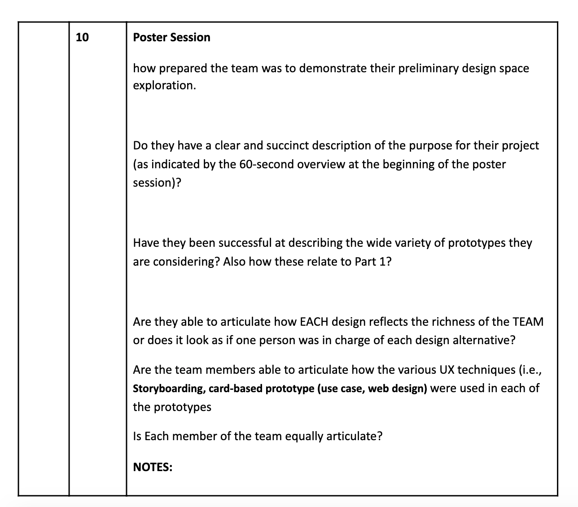
Rubric

